Slide 1


ADVERTISER PACK
2026 / 27
Reach the people
who buy.
For the people who run, buy and fund UK vans, trucks and company cars.
THEFLEETMAGAZINE.CO.UK
COGENT MULTIMEDIA LTD

Slide 2
WHO YOU REACH
The people you’re getting in front of.
THE LIST TODAY
13,259
named fleet decision makers subscribed to the newsletter.
The Fleet Magazine goes to fleet directors, fleet managers and transport managers, and the finance and procurement people who share their decisions.
28,472
average monthly visits to The Fleet Magazine website.
WHAT THEY BUY
Vehicle leasing, contract hire and funding
52.0%
average open rate against an industry average of 20%.
Telematics, tracking and fleet software
EV charging and electrification
Fuel cards, tyres and maintenance
Fleet insurance and risk management
Driver training, compliance and recruitment
5.96%
average click rate against an industry average of 2%.
THE FLEET MAGAZINE · WHO YOU REACH
2 / 7
Notes:
Subscribers: Mailchimp, subscribed members on 20 Oct 2026. Open and click rates: pooled across all 14 issues sent to this list. Visits: GA4 sessions, 2026-09-20 to 2026-10-19.

Slide 3
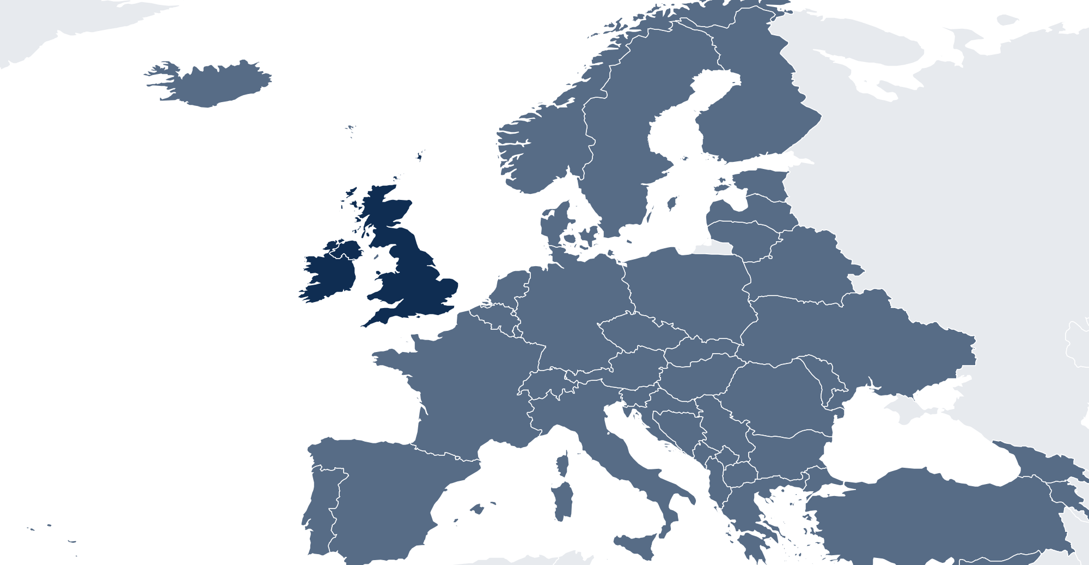
WHO READS
Who reads The Fleet Magazine
80% sit at manager level or above.
6.0%
16%
58%
20%
WHERE THEY ARE
Owner or C-suite
Director or head of
Manager
Engineers, admin and planners
MOST COMMON ROLES
Fleet manager
24%
Transport manager
22%
Operations director
10%
Depot manager
9.0%
Procurement and finance
8.0%
Fleet engineer
6.0%
92%
5.0%
3.0%
UK and Ireland
Europe
Rest of world
FLEET SIZE
COMPANY TURNOVER
SECTOR
Under 25 vehicles
20%
Under £10m
22%
Haulage and logistics
30%
25 to 99
32%
£10m to £50m
30%
Construction and trades
18%
100 to 499
30%
£50m to £250m
28%
Utilities and facilities
14%
500 or more
18%
Over £250m
20%
Public sector
12%
Retail and distribution
10%
THE FLEET MAGAZINE · WHO READS
3 / 7

Slide 4
WHAT YOU CAN BUY
Four ways in.
Every format is digital. Our subscribers have requested to receive content from brands who are able to help their business.
Website banners
Sponsored newsletter content
970×250
300×250
Your brand across the whole site.
Sponsored
Your story in our Monday Briefing, next to our editorial and labelled as sponsored.
HOW A BOOKING RUNS
728×90
01
You tell us what channels you want to use.
970×250 · 728×90 · 300×250
400 words · logo · one link
02
We confirm format, date and price in writing.
03
You send artwork, or copy and we build it.
Newsletter sponsorship
Solus email
04
You approve it before anything goes out.
Sponsor
05
We send the report on your campaign alone.
Your brand as the named sponsor of every issue of our Monday Briefing.
Your email
Your own email, sent to our subscribers. Nobody else in it.
Banner
Per issue, or sponsor a series
We build it, or send finished HTML
THE FLEET MAGAZINE · WHAT YOU CAN BUY
4 / 7

Slide 5
RATES
Build a campaign.
FORMAT
ONE
THREE
SIX
EMAIL
Our team of marketing experts can work with you to build bespoke campaigns to fit your advertising goals and strategies.
All marketing options are built to send our audience straight to your website with one easy click.
Whatever you chose, it’s designed to deliver traffic to you.
Eshot
£1,000
£750
£500
Your message alone, nobody else in it
EACH
EACH
Newsletter sponsorship
£800
£600
£400
Named sponsor of the Monday Briefing
EACH
EACH
CONTENT
Sponsored article
£200
£150
£100
On the website and in the newsletter
EACH
EACH
DISPLAY
ONE MONTH
THREE MONTH
SIX MONTH
Homescreen Pop-Up
£1,200
£2,700
£3,600
Pops up after 6 seconds
TOTAL
TOTAL
Billboard, 970×250
£900
£2,100
£3,000
TALK IT THROUGH
Top of the homepage
TOTAL
TOTAL
jb@thefleetmagazine.co.uk
Leaderboard, 728×90
£600
£1,200
£1,800
Across the site
TOTAL
TOTAL
MPU, 300×250
£400
£800
£1,200
Sidebar button
TOTAL
TOTAL
All rates exclude VAT
THE FLEET MAGAZINE · RATES
5 / 7

Slide 6
WHAT RESULTS YOU GET
The numbers
you get back.
Statistics
All numbers are an average
EMAIL CAMPAIGN
Delivered
Inboxes it actually reached
13,259
Within 7 days of your campaign finishing, you’ll receive a full performance report showing impressions, open rate and click-throughs to your website.
Unique opens
People who opened, counted once
52.0%
Unique clicks
People who clicked, counted once
6.0%
Click to open
Of those who opened, who then clicked
11.5%
Unsubscribes
Off the list after your send
0.05%
ON THE SITE
Monthly Total Visits
Total impressions on your content
28,472
WHEN YOU GET A REPORT
Monthly Unique Visitors
Unique users who saw your content
21,411
Within 7 working days of the send.
THE FLEET MAGAZINE · WHAT RESULTS YOU GET
6 / 7
Notes:
Delivered is the current list size. Rates pooled across 14 issues. Visits and unique visitors: GA4 sessions and total users, 2026-09-20 to 2026-10-19.

Slide 7
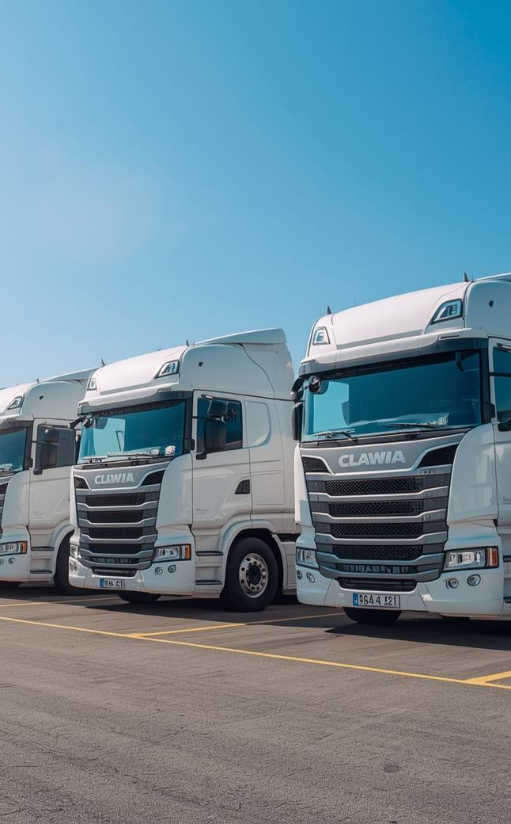
ADVERTISE WITH US
Get in touch.
Tell us who you are trying to reach and what you want it to do, and we will come back with a plan, availability and a price.
ADVERTISING
jb@thefleetmagazine.co.uk
SEND US A STORY
thefleetmagazine.co.uk/submit-news
SUBSCRIBE FREE
thefleetmagazine.co.uk/newsletter
PUBLISHED BY · COGENT MULTIMEDIA LTD, 5 JUBILEE WAY, FAVERSHAM, KENT

